Slide 1




MovieLens Big Data Analysis for A Movie Recommendation System
Presented by Group3:
Angel Ren
Bhavika Prasannakumar
Chinmaya Gayathri
Liya Li
Sai Srivathsav Aripirala
DATA 228: Big Data Technologies

Slide 2

01
INTRODUCTION

Slide 3

Exponential growth of digital content
Utilization of big data techniques
Addressing big data complexities
Leveraging the MovieLens dataset
Comprehensive dataset features

Slide 4


02
OBJECTIVES

Slide 5

Data Processing and Analysis:
Manage and analyze large-scale movie-related data using PySpark.
Gain insights into user preferences, movie ratings, and trends.
Visualization of Insights:
Create intuitive data visualizations to present complex analytical results.
Enable stakeholders to make informed decisions based on identified patterns and trends.
Advanced Employment for User Satisfaction:
Improve user satisfaction by providing accurate predictions of popular movies and relevant movie recommendations.
Utilize the results of comprehensive Exploratory Data Analysis (EDA).
Notes:
Data Processing and Analysis:
Manage and analyze large-scale movie-related data using PySpark.
Gain insights into user preferences, movie ratings, and trends.
Employ data manipulation techniques such as filtering and aggregation.
Visualization of Insights:
Create intuitive data visualizations to present complex analytical results.
Enable stakeholders to make informed decisions based on identified patterns and trends.
Utilize Python libraries like Matplotlib and Seaborn for representing data trends and patterns.
Advanced Employment for User Satisfaction:
Improve user satisfaction by providing accurate predictions of popular movies and relevant movie recommendations.
Utilize the results of comprehensive Exploratory Data Analysis (EDA).
Recommend movies similar to those users have liked, based on shared features or characteristics of the movies.

Slide 6
03
MOTIVATION

Slide 7


Responding to the Surge in Digital Content
Harnessing Advanced Big Data Analysis Techniques
Personalization of Movie Recommendations
Comprehensive Data Analysis for Insight Extraction

Slide 8
04
PROBLEM STATEMENT

Slide 9
To address this problem, the project will undertake comprehensive exploratory data analysis (EDA) of the rich MovieLens dataset, which includes metadata for over 45,000 movies.
The challenge lies in extracting valuable insights from this extensive dataset, encompassing a wide range of film industry features, and translating these insights into accurate and relevant movie recommendations.
The central problem addressed by this project is to leverage sophisticated big data analysis techniques, specifically using PySpark, to manage and interpret this large-scale movie-related data.
The goal is to develop a dynamic, personalized movie recommendation system that not only caters to individual user preferences but also adapts to emerging trends and patterns in viewer behavior.

Slide 10



05
DATA SOURCES

Slide 11
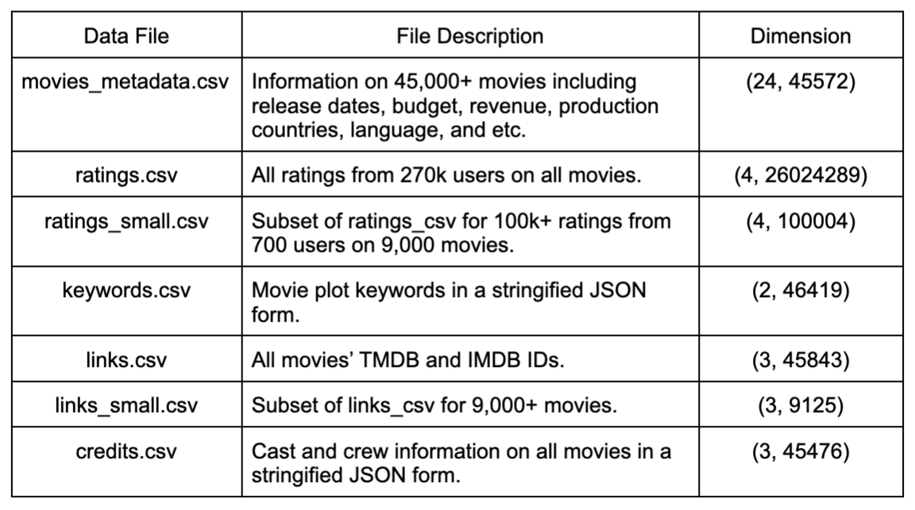
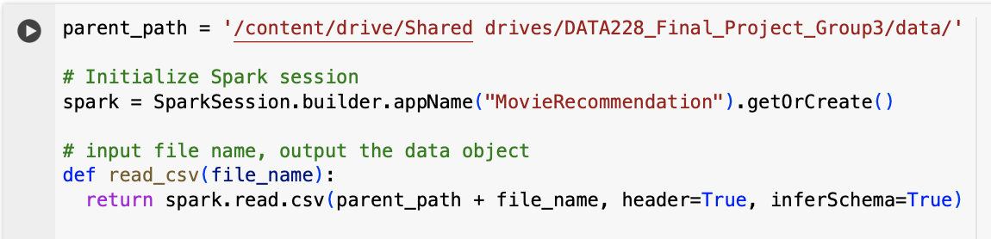
The Movies Dataset - MovieLens
https://www.kaggle.com/datasets/rounakbanik/the-movies-dataset/data
Total of 7 csv files containing metadata and all other information for 45,000 movies listed in the Full MovieLens dataset. The main ones we are using for this project are movies_metadata.csv and ratings_small.csv based on the sources we have (GPU, RAM, etc).
Latest movie release time is July 2017 in this dataset.
There are about 26 million ratings from 270k users on a scale of 1-5.

Slide 12
06
DATA PRE-PROCESSING

Slide 13
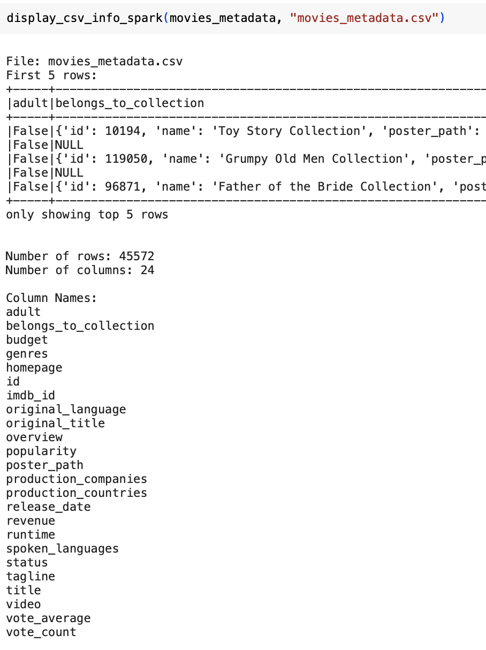
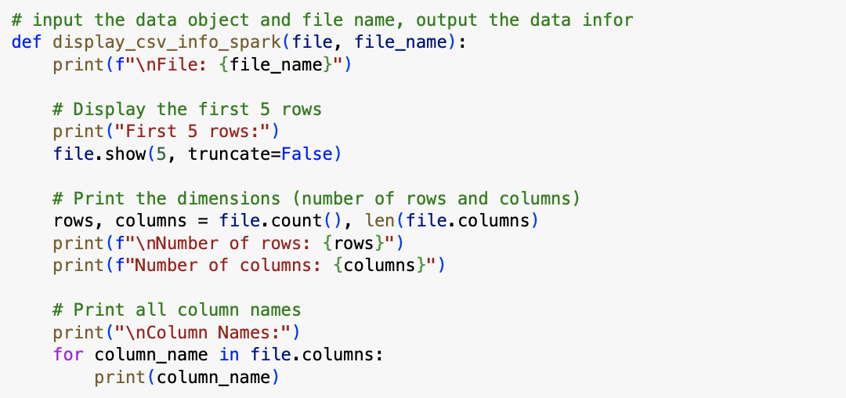
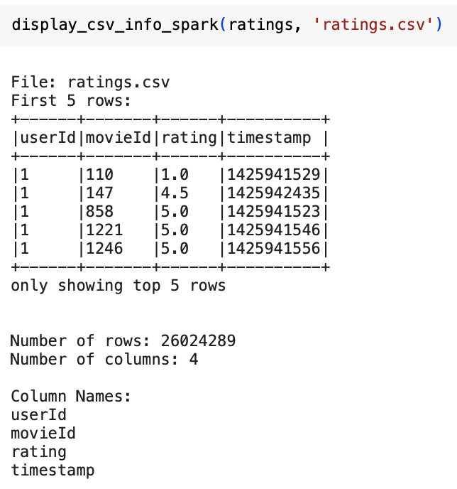
Display_csv_info_spark kicks in the function of showing first 5 rows of the dataset, print dataframe dimension and all column names.
Here’s the same output for the main dataset: movies_metadata.csv:
45572 rows
24 columns (title, revenue, release_Date, id etc)
Notice that each user can rate multiple movies so this dimension is not the final one for our exploration. Will explain more.

Slide 14
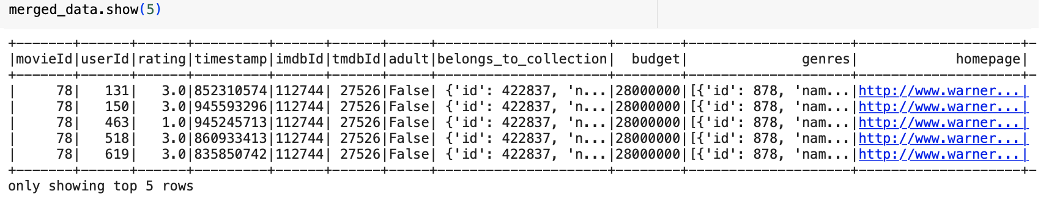
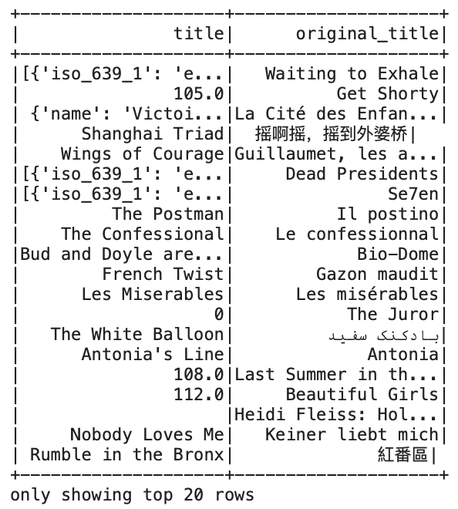
The movie_metadata.csv comes in pretty clean already but we want to improve the quality a bit more.
We merge it with the ratings.csv.
Handle missing data —> drop all N/A data and result in (30, 757109).
Remove features that are not so important to this project —> drop ‘imdb_id’ column.
Check if the movie has foreign original title
—> yes, so we drop the ‘original title’ column and use only ‘title’
For movie revenue as 0, that means there’s no known information about it
—> replace the 0’s with N/A. Drop as needed.
Create two new features for future needs
—> ‘year’ as released year, and ‘return’ as the ratio of revenue to budget.

Slide 15
07
EXPLORATORY DATA ANALYSIS

Slide 16
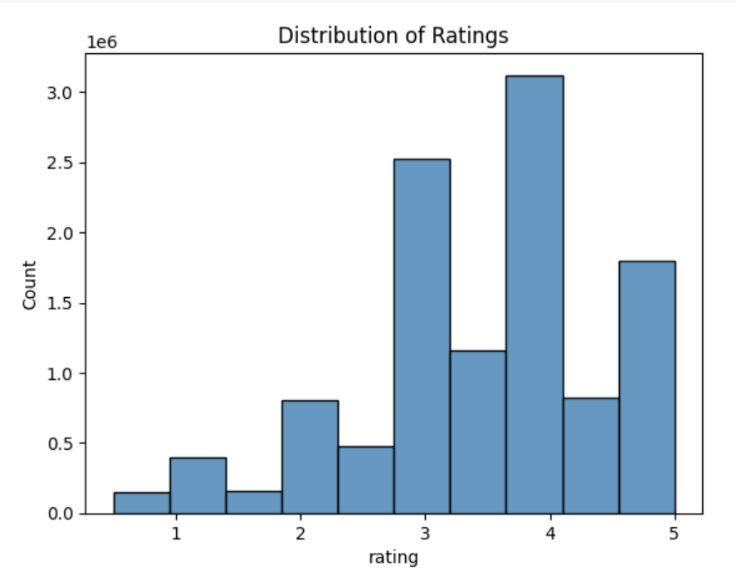
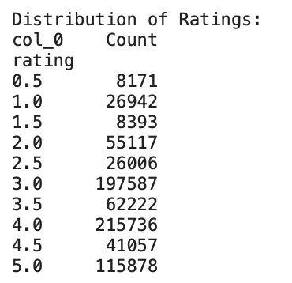
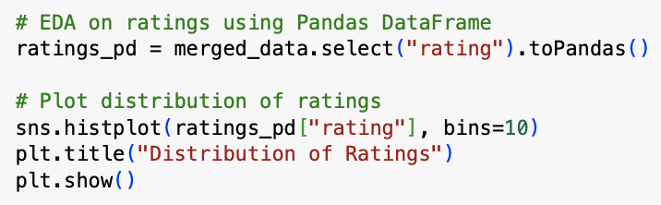
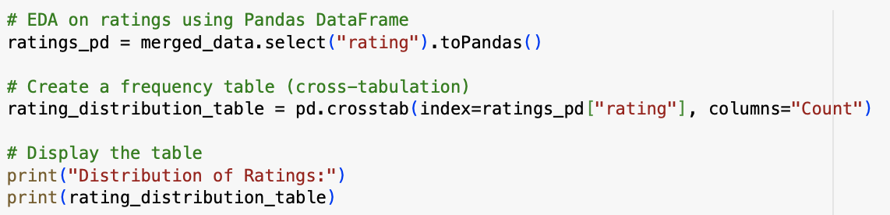
What are the ratings distributions?
The most given ratings is 4 / 5 which is a pretty good scores. In fact, there are a lot of full scores ratings.

Slide 17
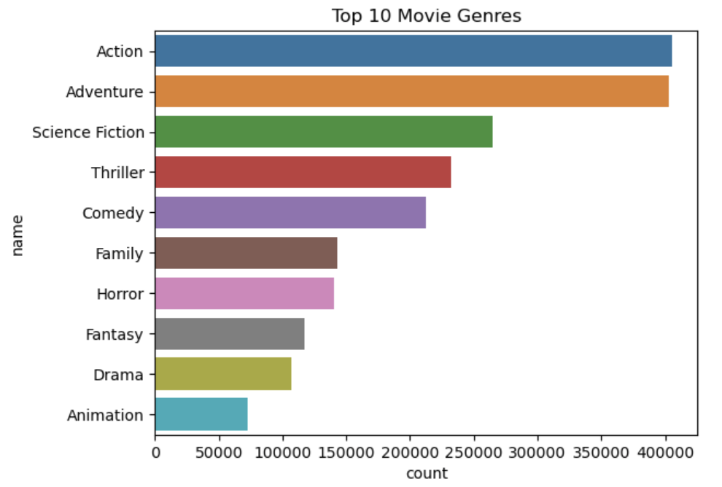
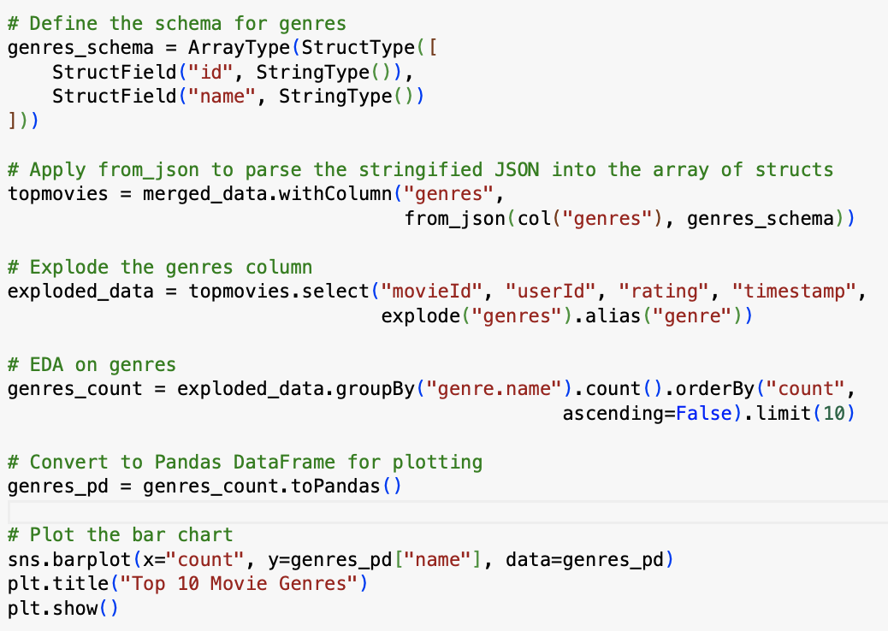
Top 10 Movie Genres
Action movies have the most ratings, similar amount of the second one adventure movies.This indicates favorable trends.

Slide 18
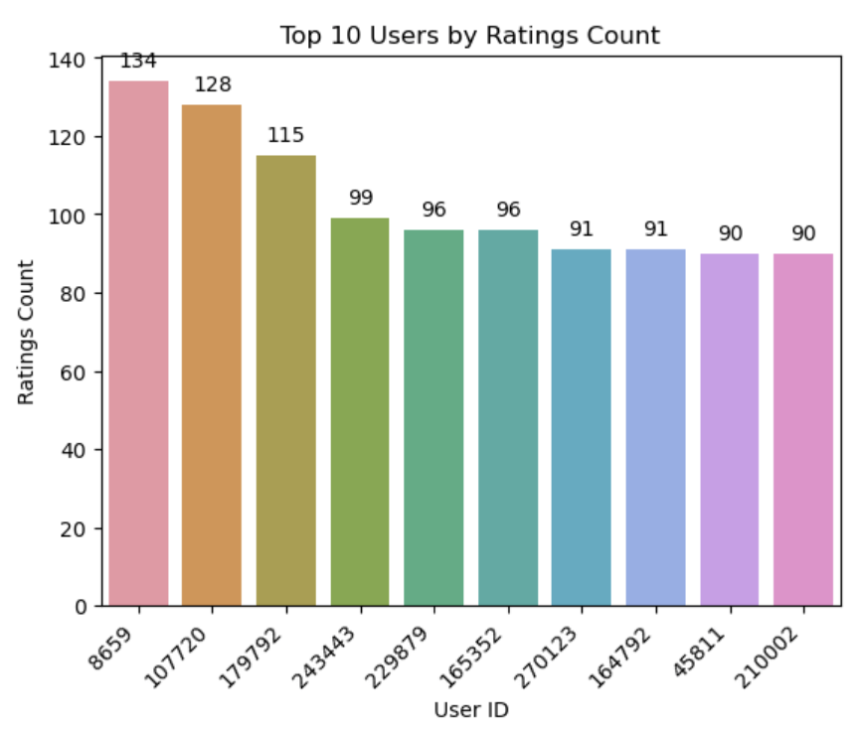
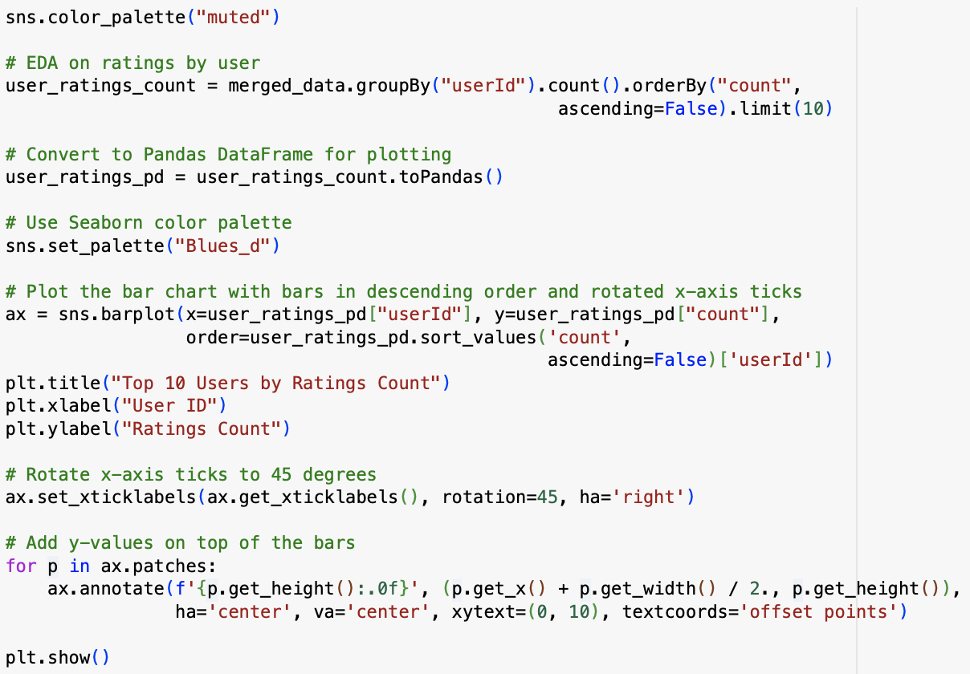
Top 10 Users by Rating Count
UserID with 8659, 107720 and 179792 had contributed more than 100 ratings.

Slide 19
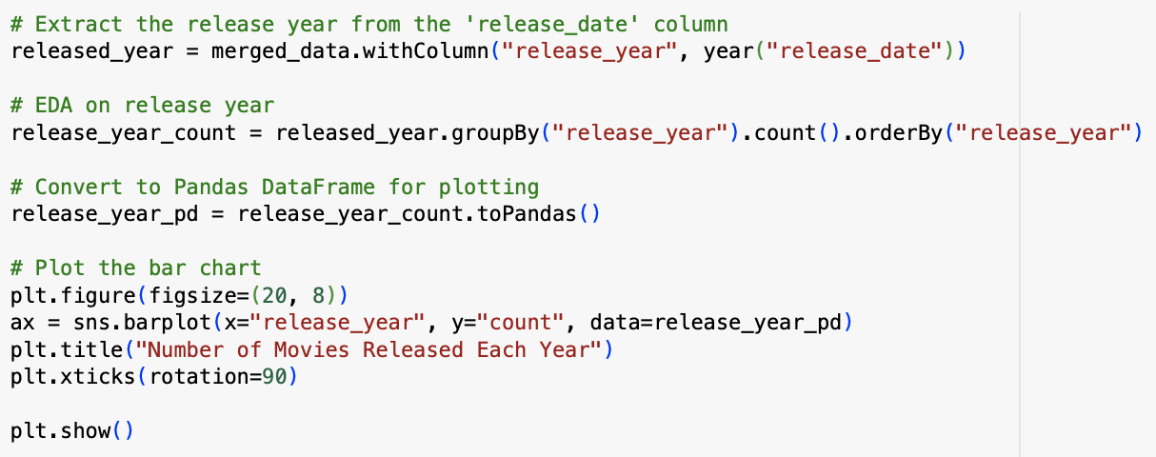
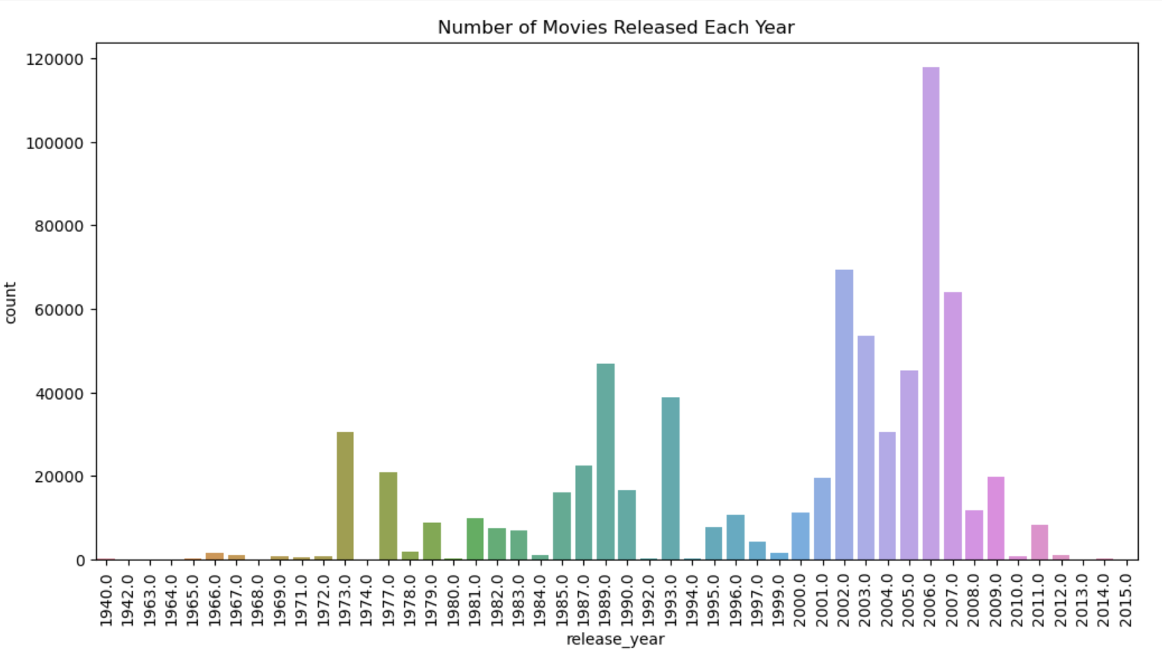
Number of Movies Ratings By Year
Approximately after 2002, movie ratings increased more than twice. Especially in 2006, we can see the most movie ratings were given, up to about 120k.
Ratings
*visz title should be: Number of Movies Ratings by Year

Slide 20
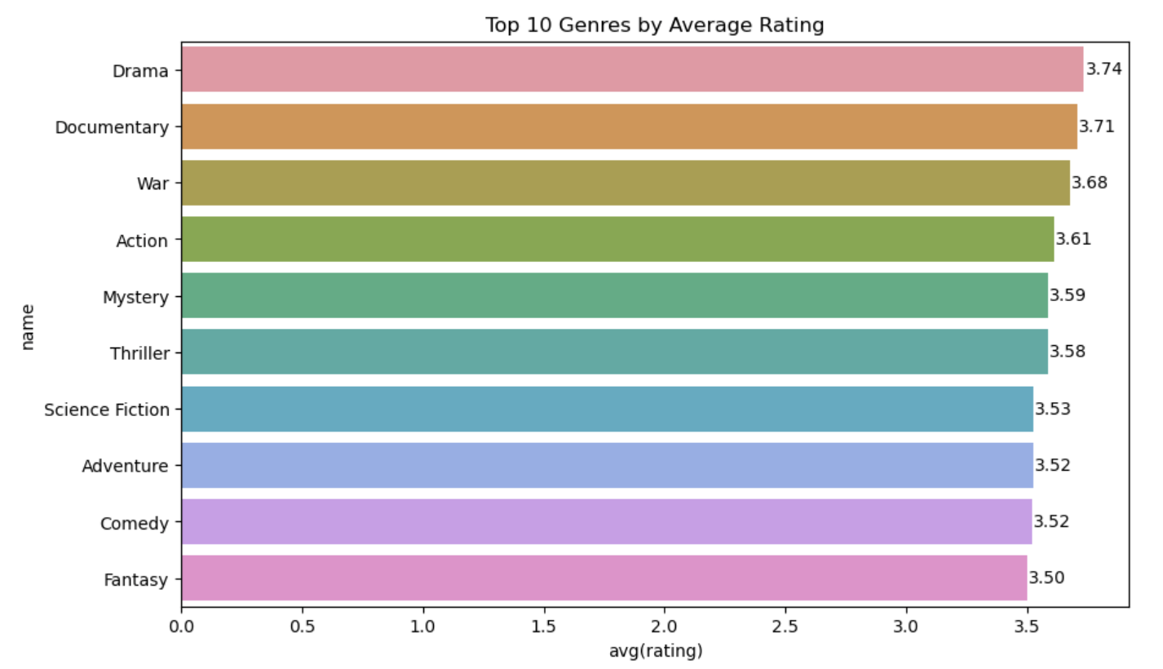
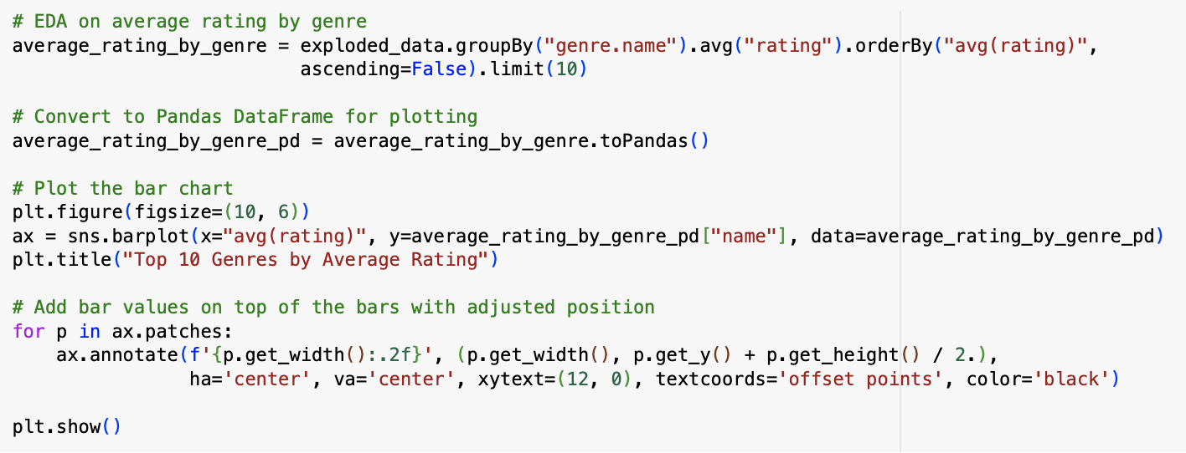
Top 10 Genres by Average Rating
Top 10 genres by average ratings include Drama movies with avg 3.74, Documentary movies with avg 3.71 and war movies with avg 3.68.
It’s interesting to see that drama movies do not have the most ratings counts but are actually rated with higher avg scores.

Slide 21
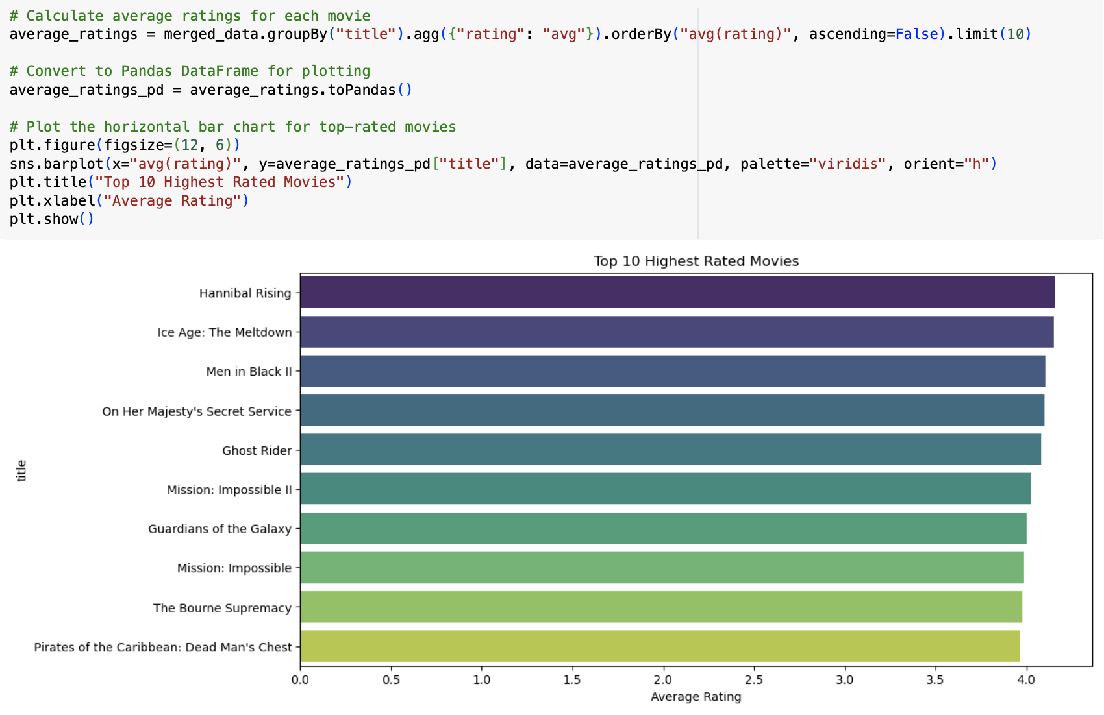
Top 10 Highest Rated Movies
These are all known famous movies. The avg ratings for Hannibal Rising, Ice Age: The Meltdown and a few are over 4 points.
Notice that this result is matching with the previous visz - Action and Adventure movies win the most ratings..

Slide 22
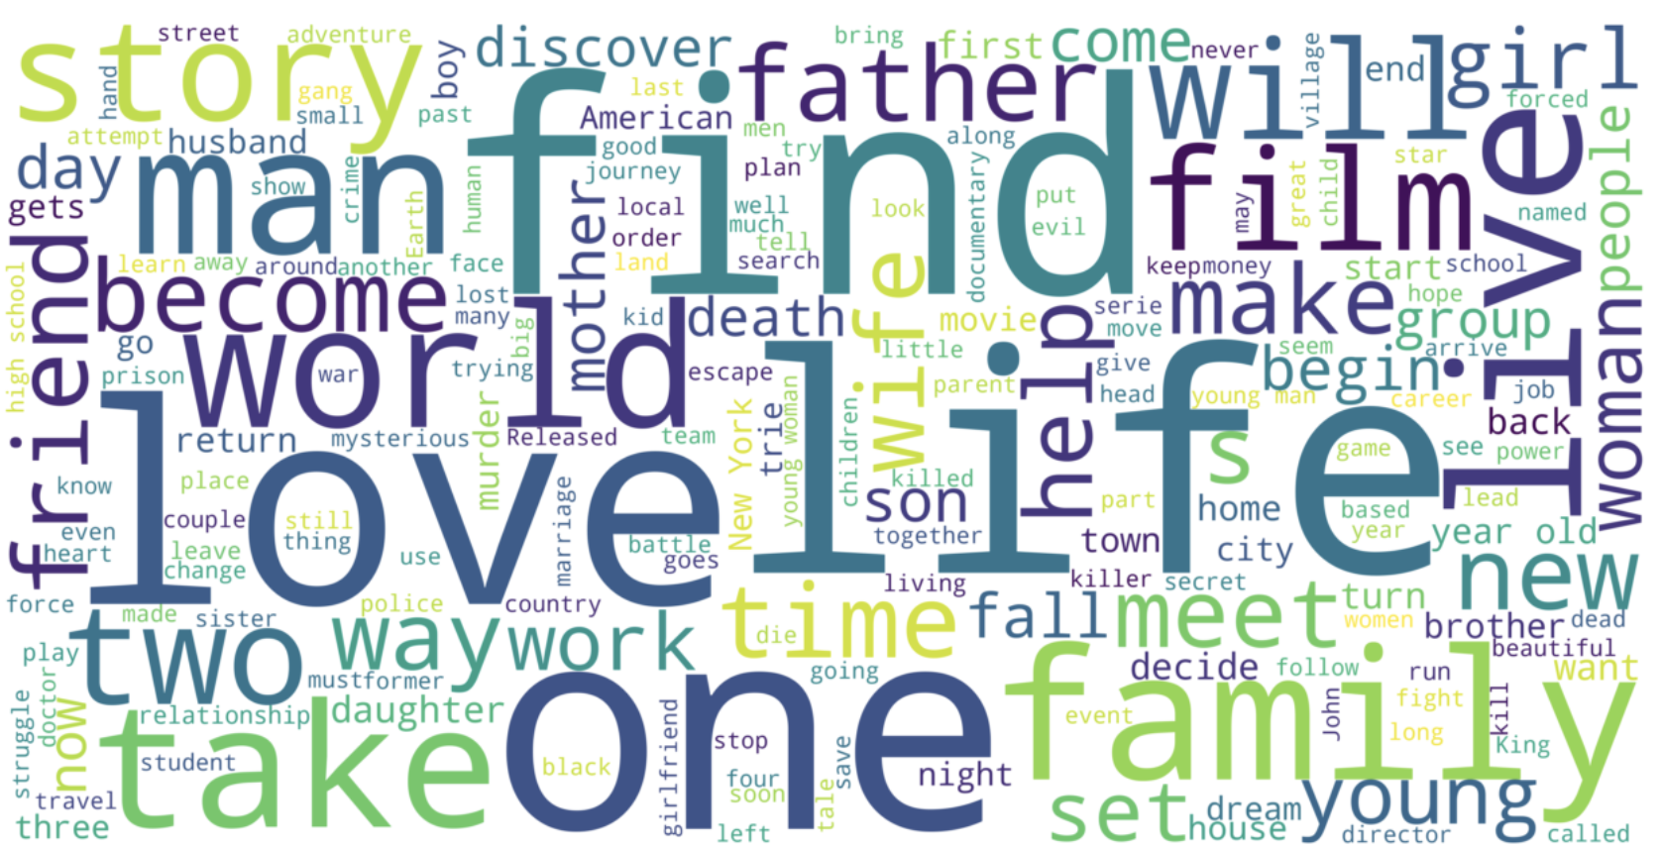
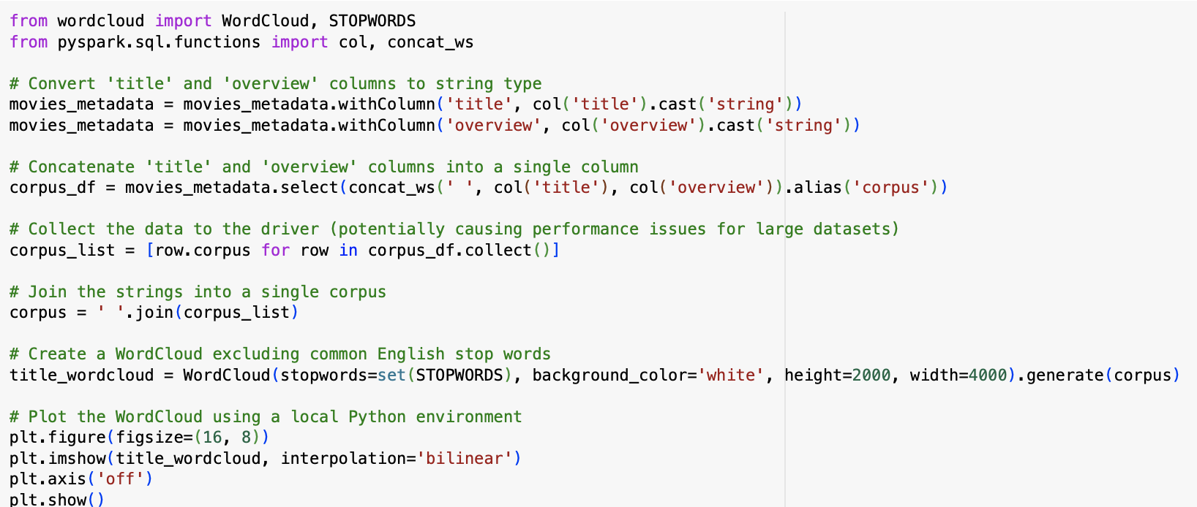
Word Cloud for Movie Title Column
“find”, “life”, “one”, “love” along with “story”, “world”, “live”, “family” and etc showed up in the movie titles the most often. We can see that movie titles containing some of these popular wordings may benefit a boost of ratings count.

Slide 23
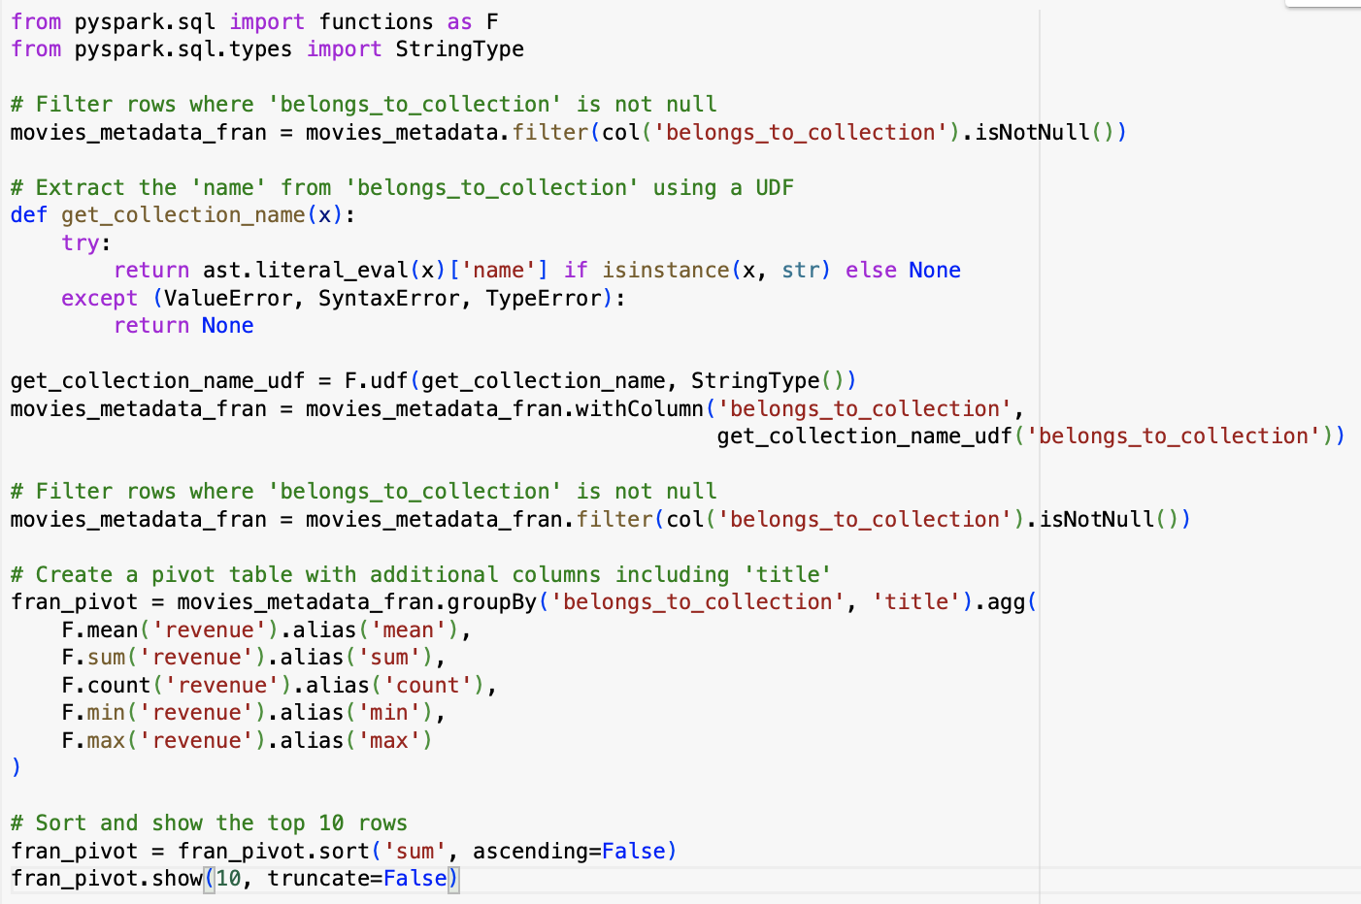
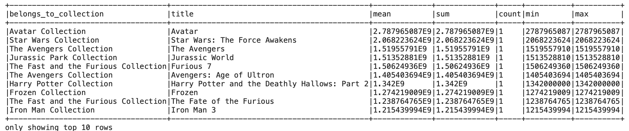
What are the highest grossing franchises?
The results show that Avatar is the highest grossing movie and it’s part of the Avatar Collection.
Another interesting finding is that, Two Avengers Collection movies are on this list and they have high grosses.

Slide 24
EDA Conclusion
Factors that attract users to give ratings, especially good ratings, are including year of release, movie genres, movie title wordings
Movie genres that receive the most ratings are not necessarily rated the highest. This suits the reality because bad ratings are still a big portions of ratings based on the data here.
For movies that are the highest grossing franchises made, we know that almost everybody knows those names and enjoy those movies. This also suits the reality because it makes sense to see popular movies getting a lot of good feedbacks. That’s what is proving these movies good movies.
However, if a movie makes good revenue, it doesn’t mean that all movies in the same collection do. We can assume that when recommending movies to a user, it’s not always the case to recommend the whole series.

Slide 25
08
MODELS

Slide 26
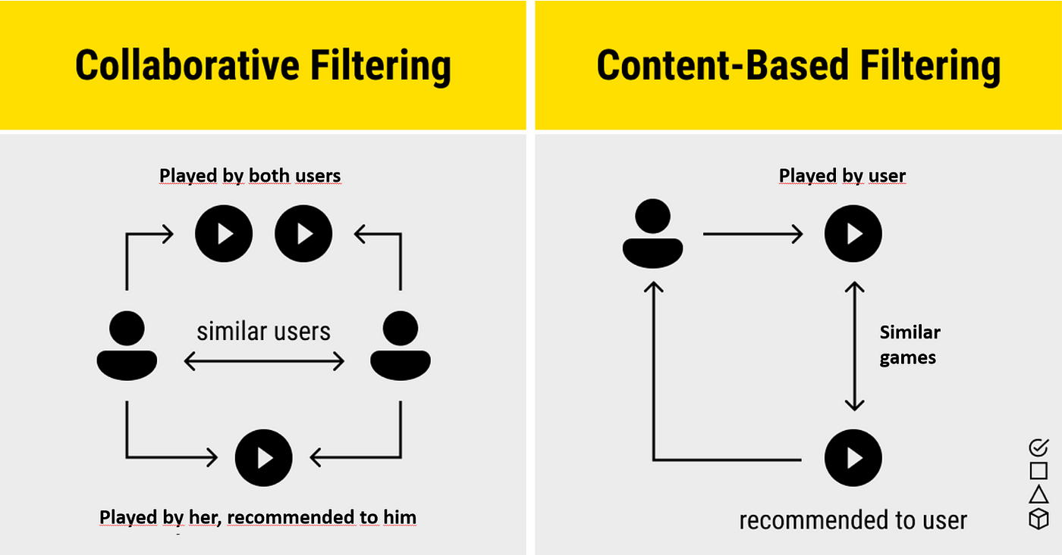
Altering Least Square (ASL) Model
X * Yt = R is how ALS calculates the ratings matrix R, which is the product of two lower-rank matrices, X and Y. These estimates are commonly referred to as "factor" matrices. Iterative approaches are generally used. One of the factor matrices is kept constant throughout each iteration, and the other is found using least squares. Next, while resolving the other factor matrix, the recently solved factor matrix is maintained constant.

Slide 27
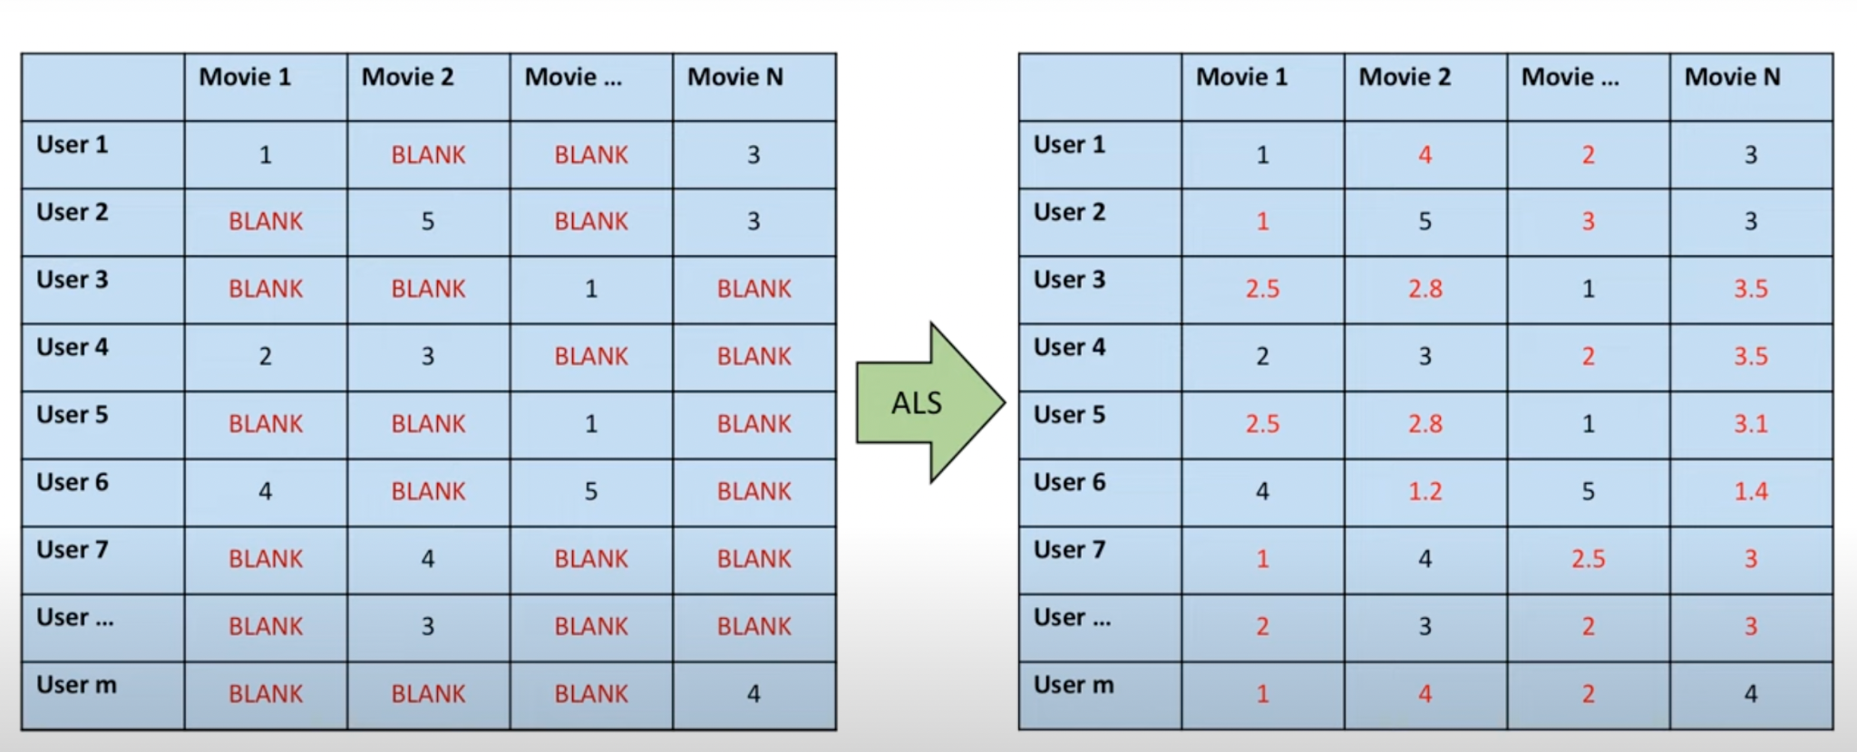
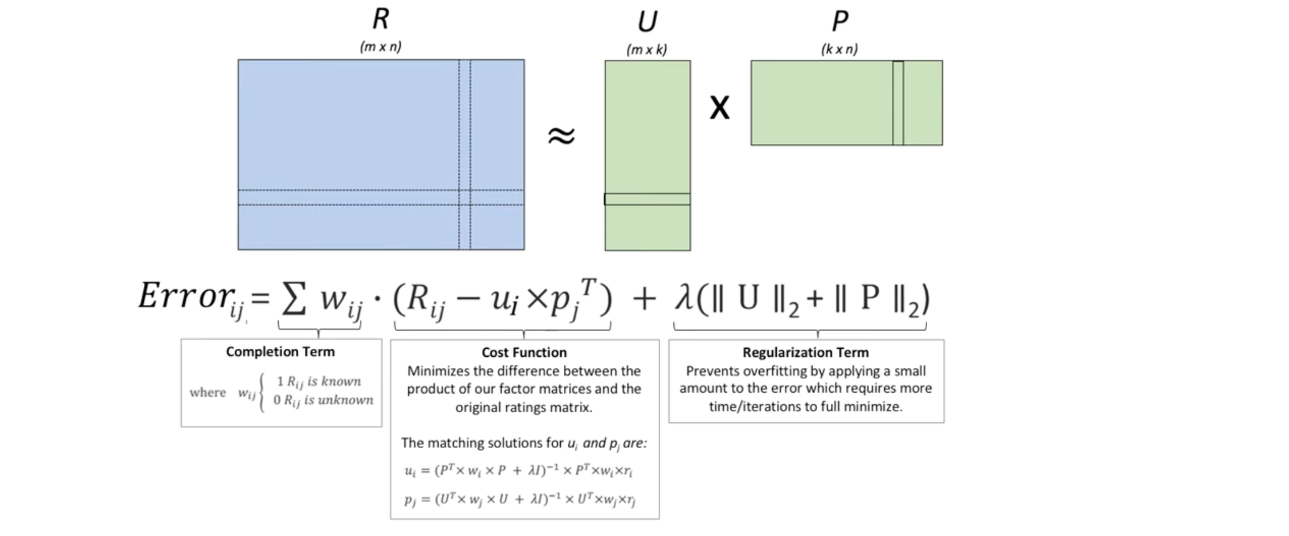
Altering Least Square (ASL) Model

Slide 28
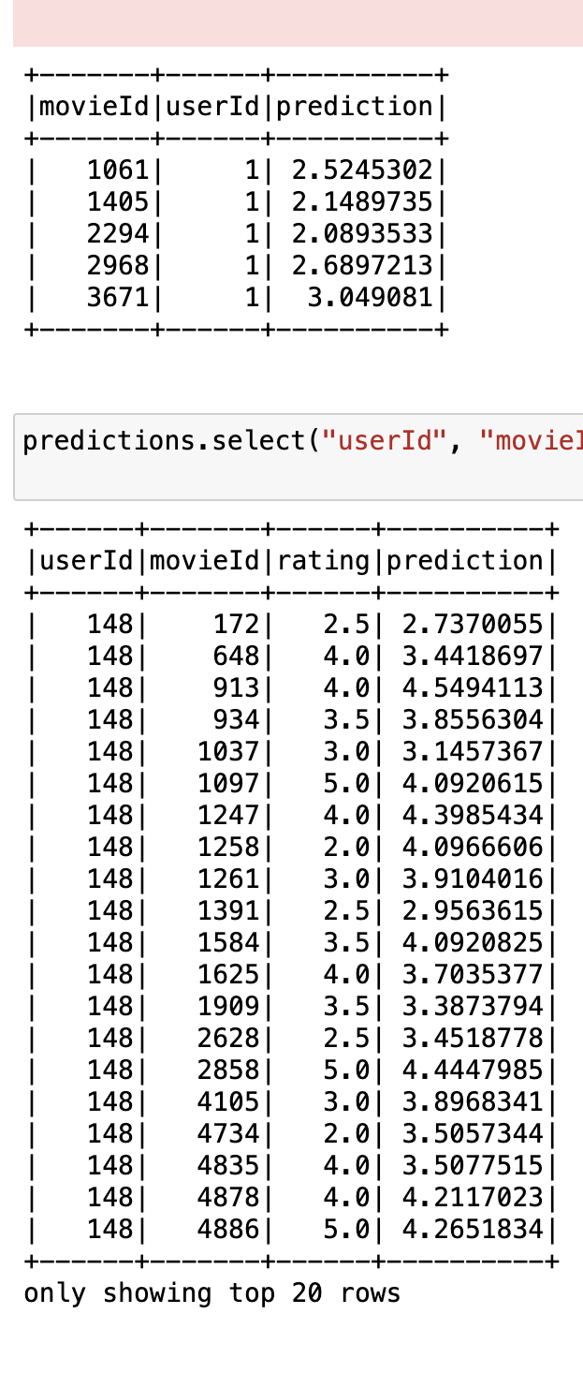
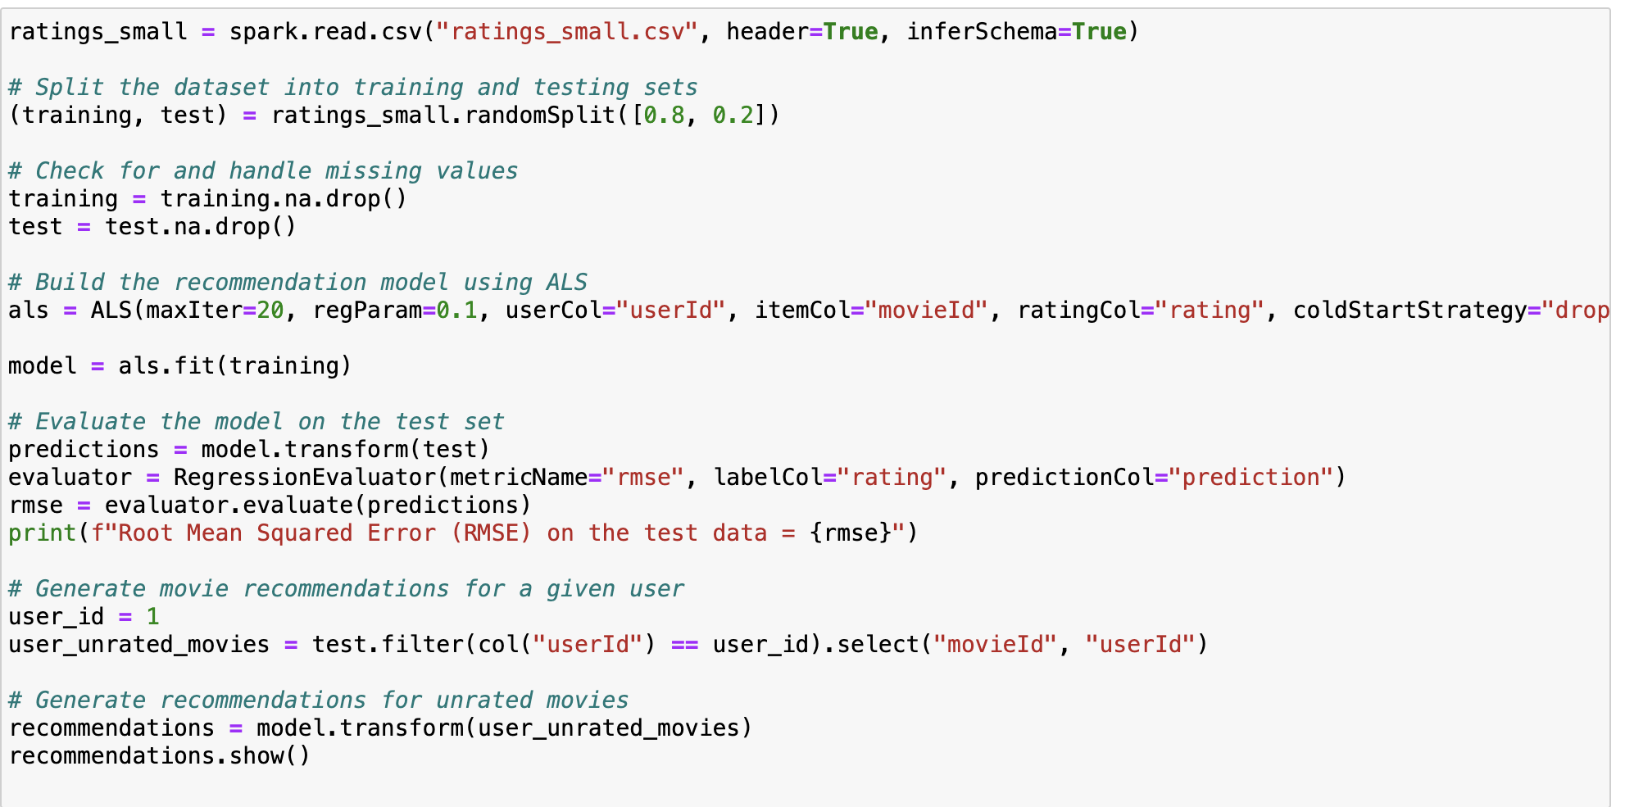
Sample Testing model & Results

Slide 29
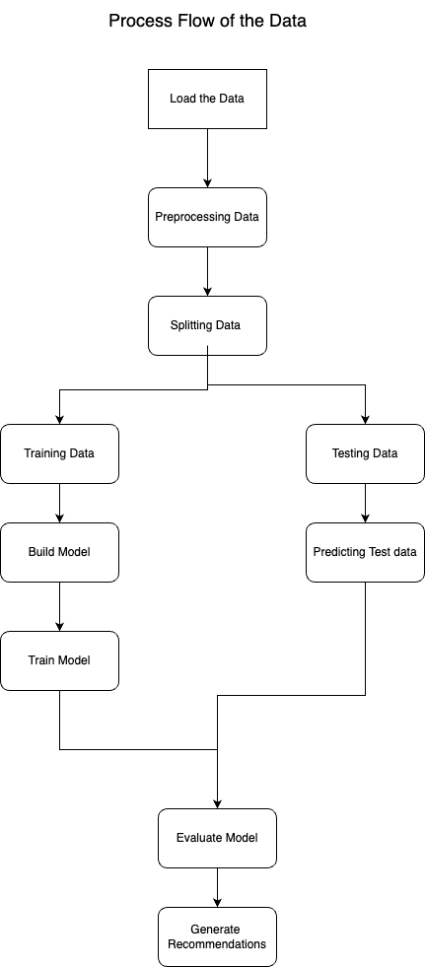
FlowChart of the Model
Load the Data:
A CSV file called "ratings_small.csv" is used to import the ratings data into a Spark DataFrame called ratings_small. We assume that the data has columns with names like "userId," "movieId," and "rating."
Splitting the Data:
The randomSplit method divides the dataset into training and testing sets. Twenty percent of the data is set aside for testing (test set), while the remaining eighty percent is set aside for training (training set).
Merge the Data
merged_data DataFrame to appropriate data types (userId to int, movieId to int, rating to float).

Slide 30
Construct the ALS Model:
The ALS class from Spark's MLlib is used to generate the Alternating Least Squares (ALS) recommendation model. Important variables consist of:
maxIter: Maximum iteration count (5 in this example).
regParam: The regularization parameter (in this case, 0.1) to prevent overfitting.
The names of the columns in the DataFrame that show user, item, and rating information userId, movieId, rating.
coldStartStrategy: Managing plan for problems arising from cold starts (users or objects not observed during training). Since it's set to "drop," no new users or objects will be added while the prediction is being made.
Train the Model:
On the training set, the fit approach is used to train the ALS model.

Slide 31
Prediction:
The model generates predictions on the test data.
Evaluate the Model:
The Root Mean Squared Error (RMSE) is the evaluation statistic that is used to assess the trained model on the test set. The discrepancy between expected and actual ratings is measured by RMSE.
Generate the Recommendations:
For a certain user (in this case, user with ID 8659), recommendations are created. Lastly, it uses the movies_metadata DataFrame and the movie IDs from the recommendations to display information about the suggested films, including title, genres, release date, vote average, and vote count. Keep in mind that movies_metadata need to be a DataFrame with information on movies.

Slide 32
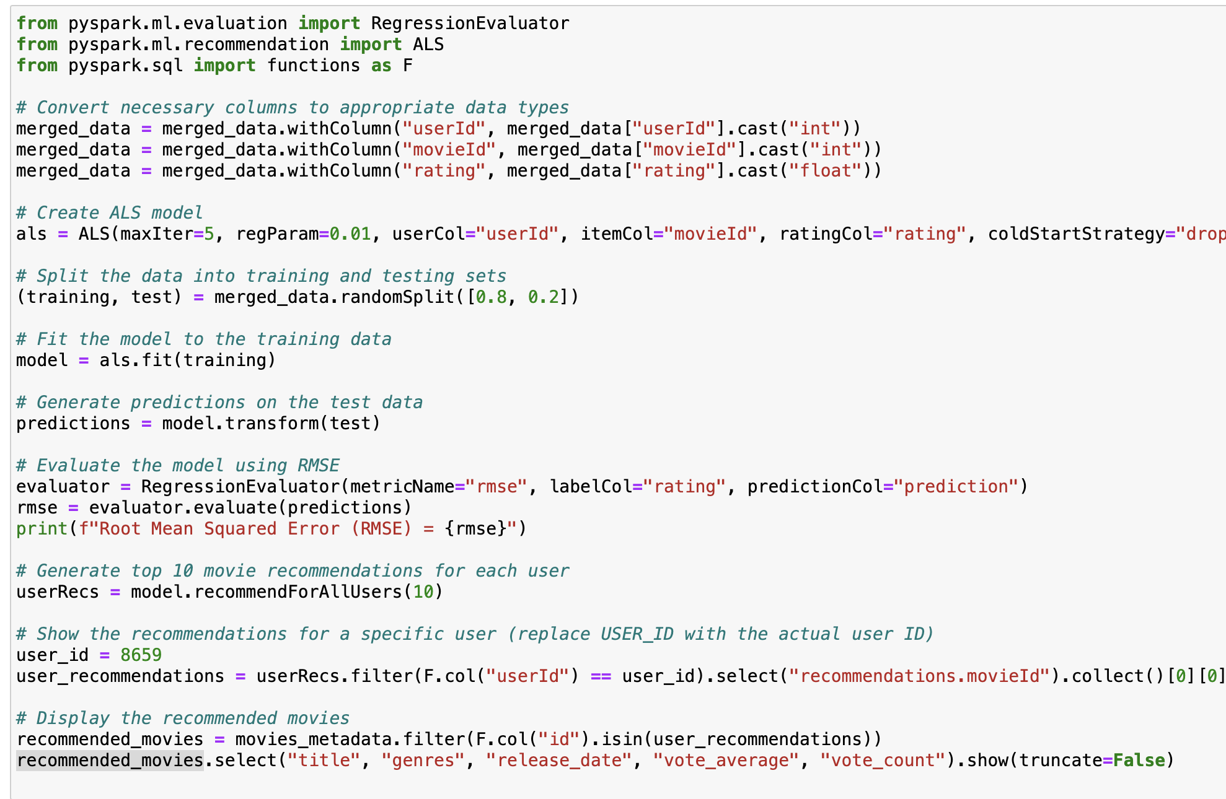
Altering Least Square (ASL) Model (Recommendation)

Slide 33

Singular Value Decomposition(SVD)
The elements of the matrix are determined by the ratings of the users, and SVD creates a matrix with a row of users and columns of things. By splitting a matrix into three smaller matrices, singular value decomposition can be used to recover the factors from the factorization of a high-level (user-item-rating) matrix.

Slide 34
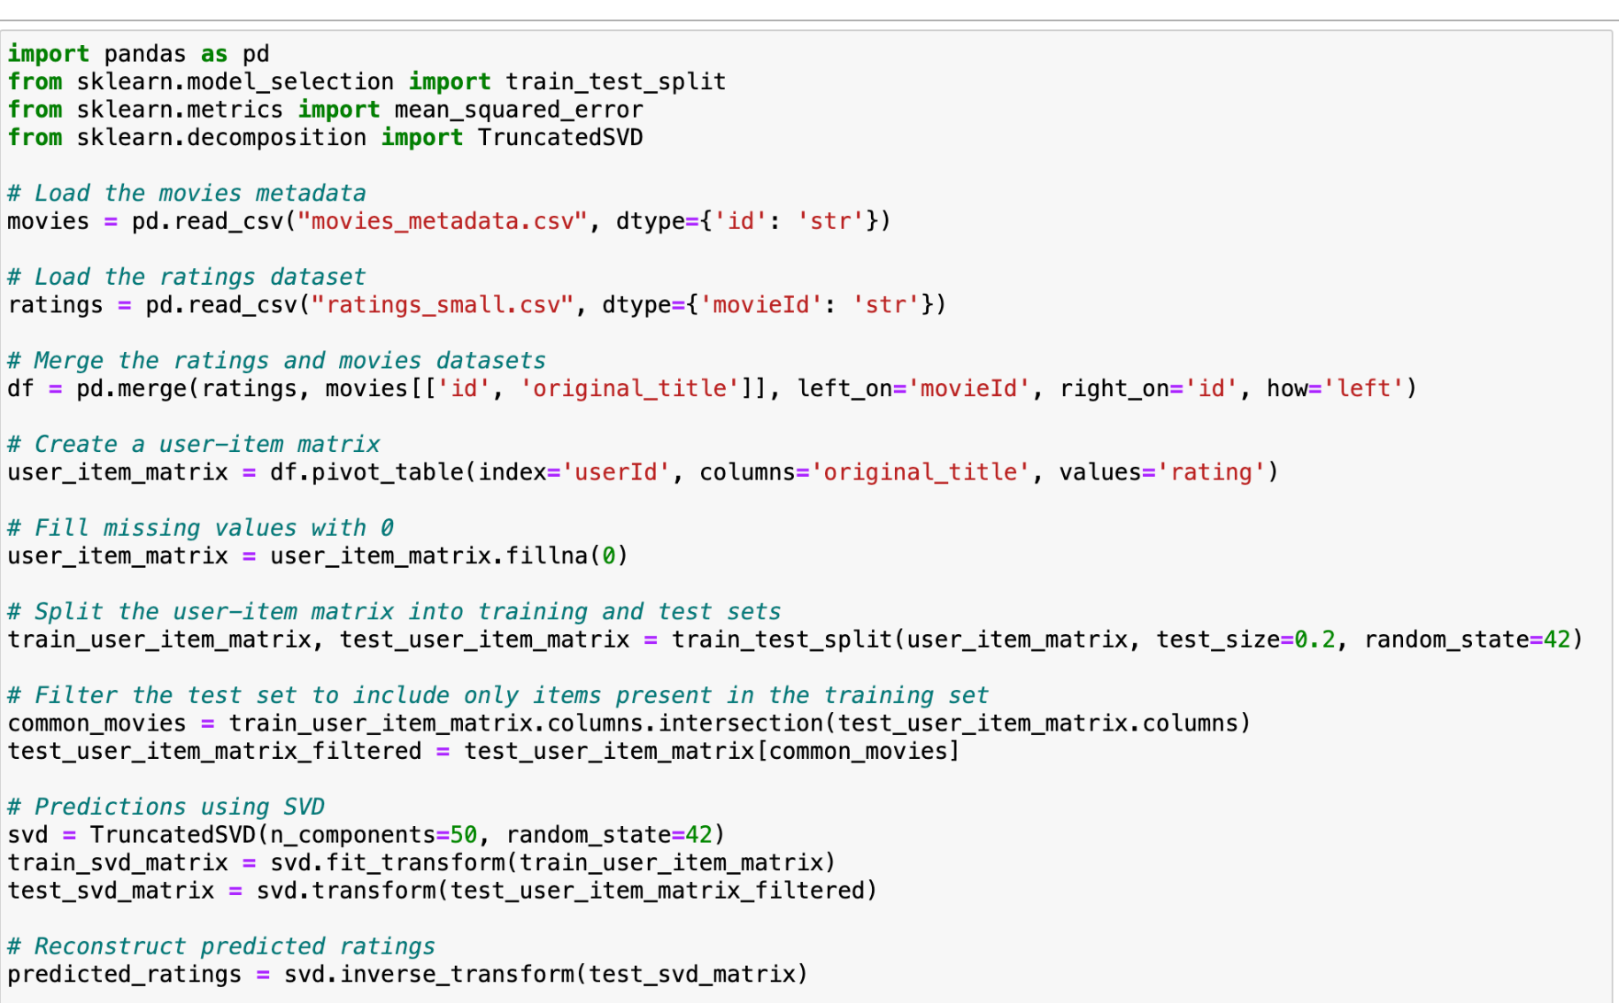
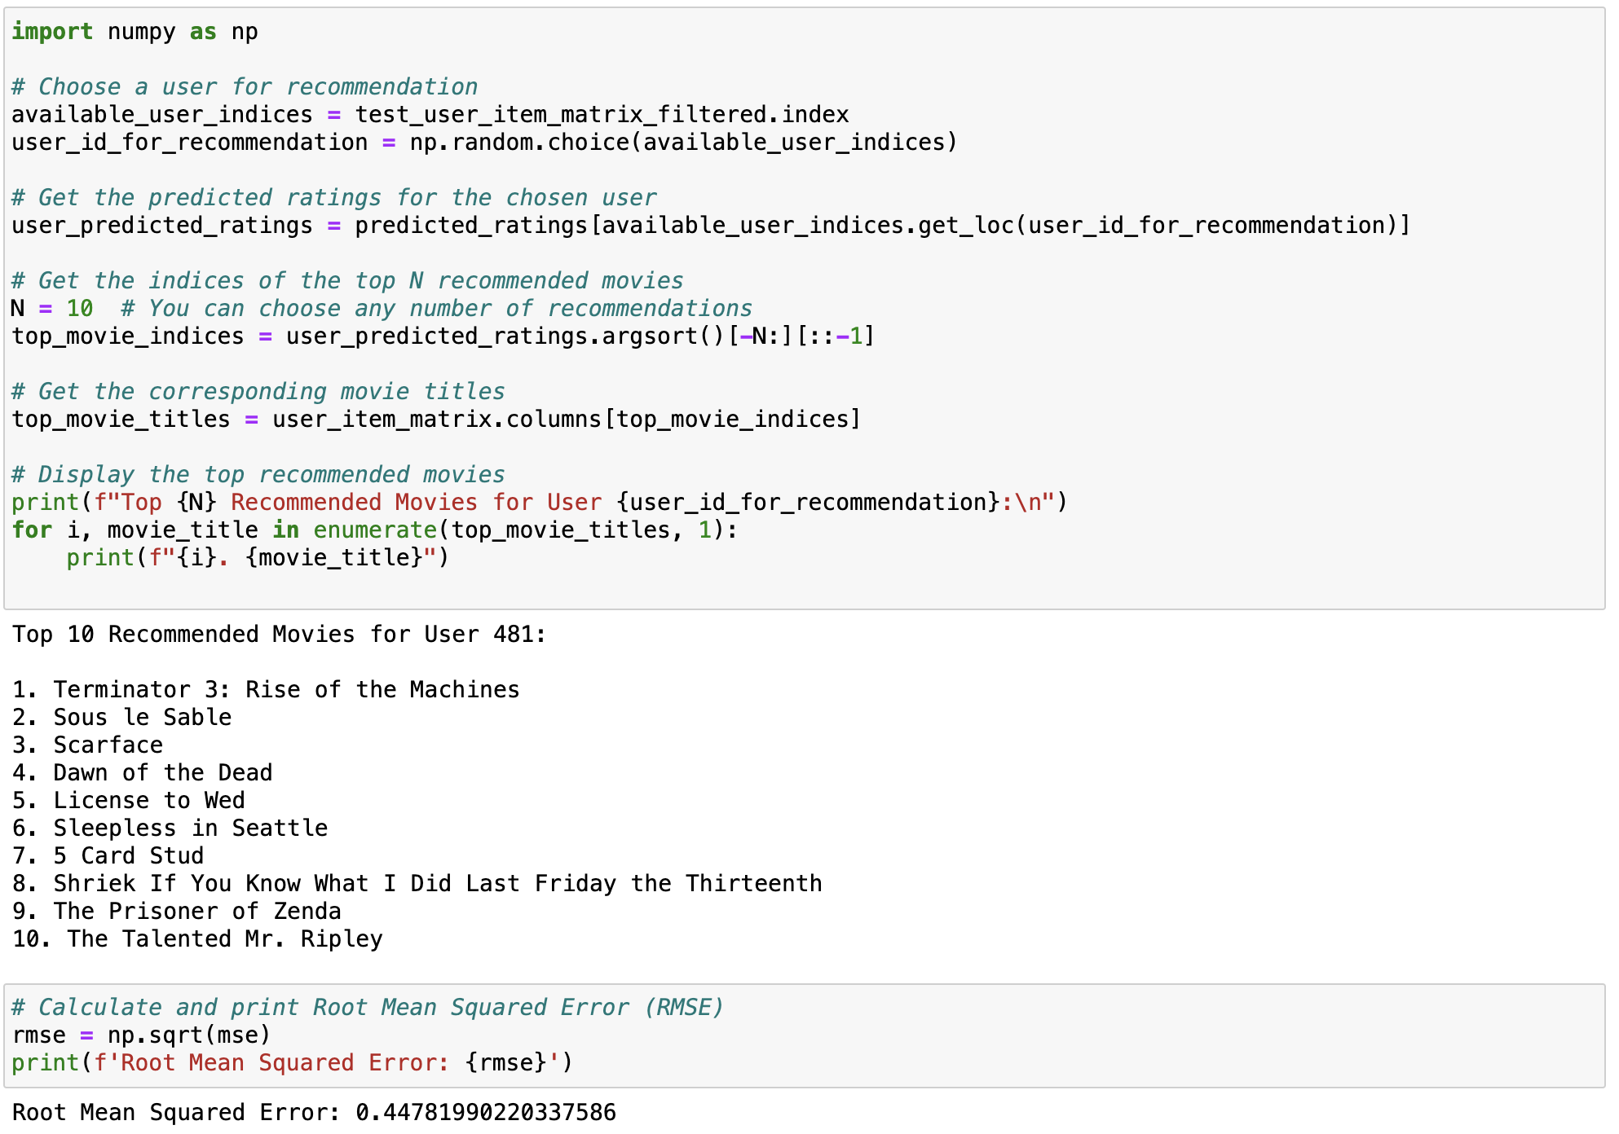
SVD Model

Slide 35
09
Results

Slide 36
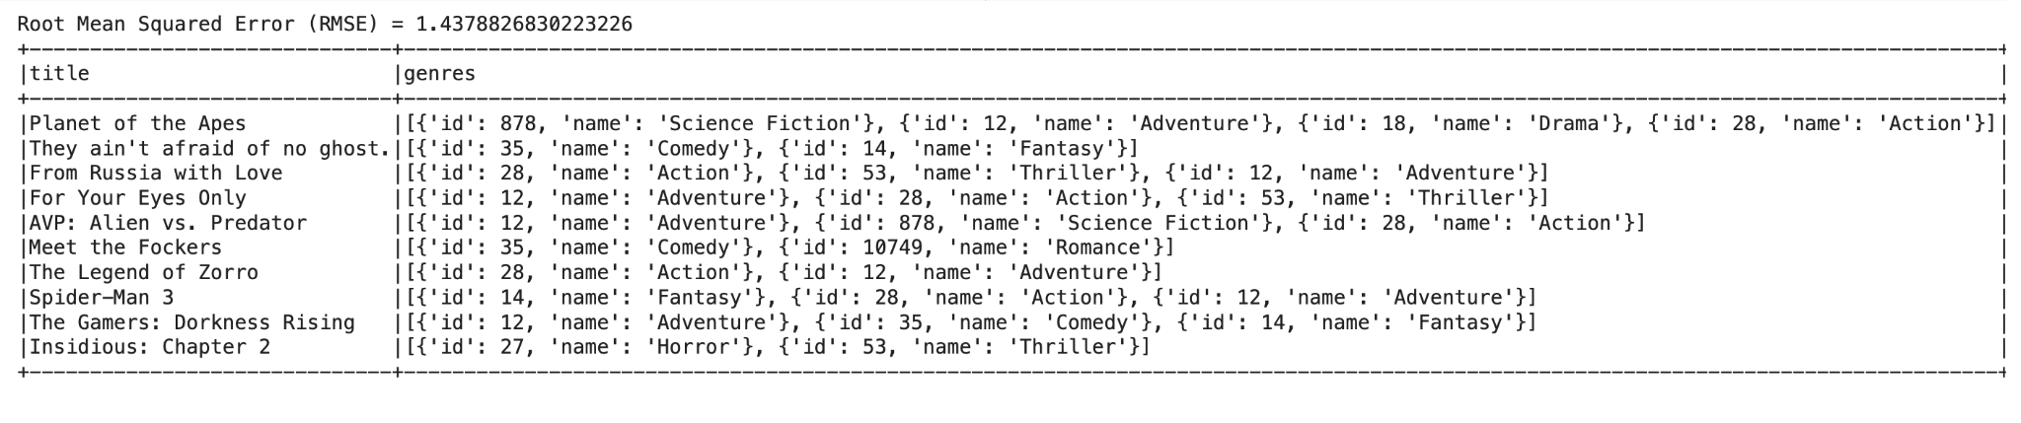
ALS Results
The PySpark ALS model achieved a commendable RMSE of 1.44, showcasing its effectiveness in providing reliable movie recommendations, despite a slightly higher scale on the RMSE.

Slide 37
SVD Results
the Python SVD model demonstrated impressive precision with a lower RMSE of 0.45, indicating its capability to deliver accurate and fine-tuned movie recommendations, highlighting its strength on the RMSE scale.

Slide 38
Modeling Conclusion
In conclusion, our MovieLens Big Data Analysis project, employing both PySpark's ALS model and Python's SVD model, has yielded promising results in crafting a dynamic movie recommendation system. The PySpark ALS model demonstrated a Root Mean Squared Error (RMSE) of 1.4378826830223226, while the Python-based SVD model exhibited a lower RMSE of 0.44781990220337586. These metrics signify the accuracy of our recommendation algorithms in predicting user preferences based on historical movie ratings.
The PySpark ALS model does a decent job, with an RMSE of 1.44, predicting what movies users might like. It's good at handling lots of movie data quickly, which is helpful when there's a ton of information to process.
On the flip side, the Python SVD model, with a RMSE of 0.45, is precise in figuring out what users prefer in movies. It's like having a finer understanding of what makes users tick when it comes to choosing films. However, it might slow down a bit when dealing with really big datasets.
To sum it up, both models have their perks. If you've got tons of data and need things to run fast, the PySpark ALS model is your go-to. But if you want super accurate recommendations and don't mind a bit of a slowdown with large datasets, the Python SVD model is the way to go. It all boils down to what exactly your movie recommendation system needs.

Slide 39


